Slide 1


Understanding the Role of a
Data Business Analyst
Data Business Analyst
2025

Slide 2

Data Cleaning
Deleted the column that has many NULL values
Discharge Date
Admitted Date
Replaced Blank / NaN
Room Type
Insurance Coverage
Checked for duplicates
2025

Slide 3
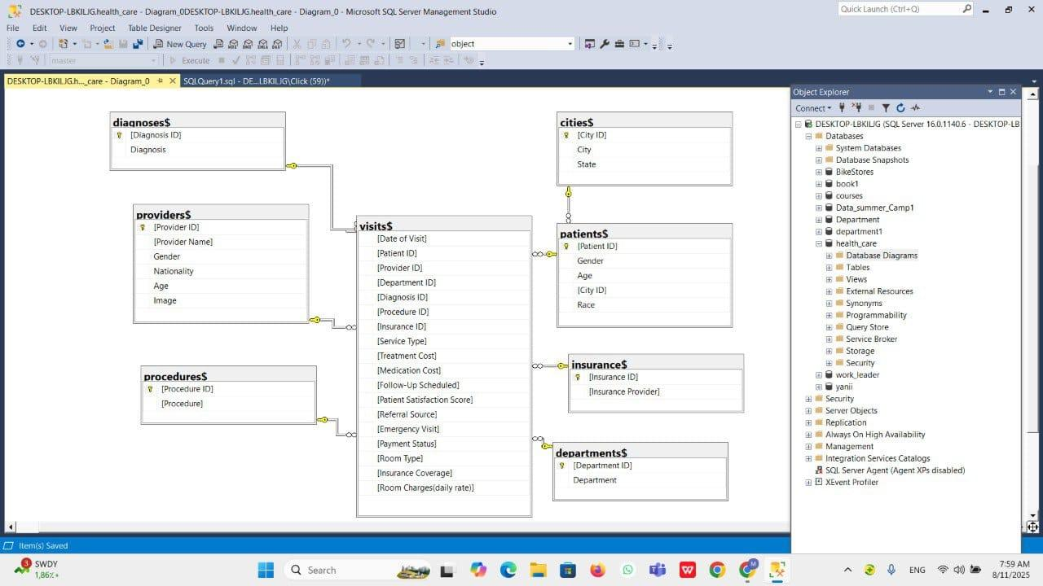
Data Business Analyst

Slide 4


connecting with tools
connet with :
power BI
Excel
Extracting data for tools
creating view
Data Business Analyst
combine all tables in one table by using primary keys and
foreign keys
for python

Slide 5
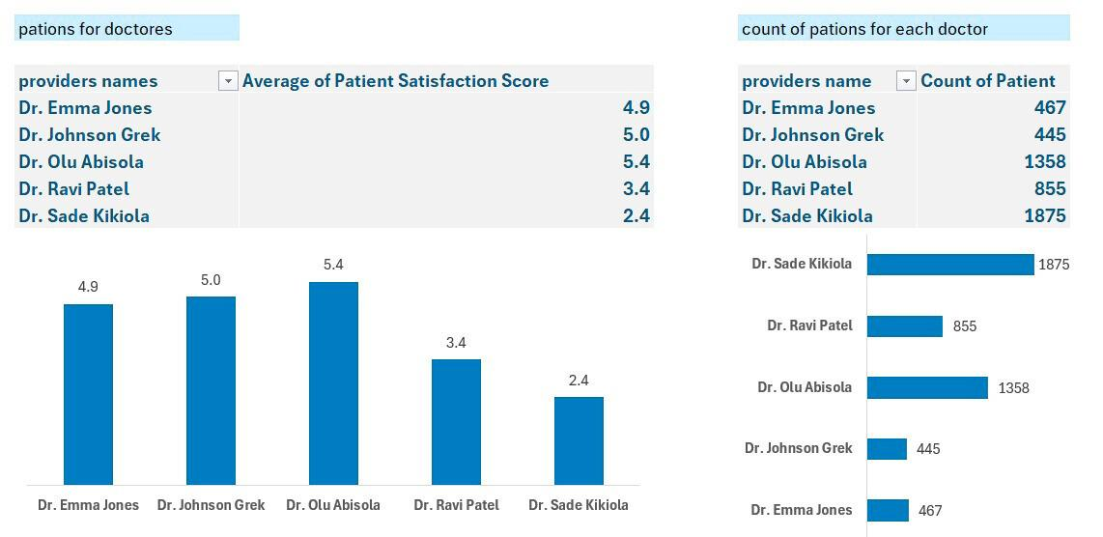
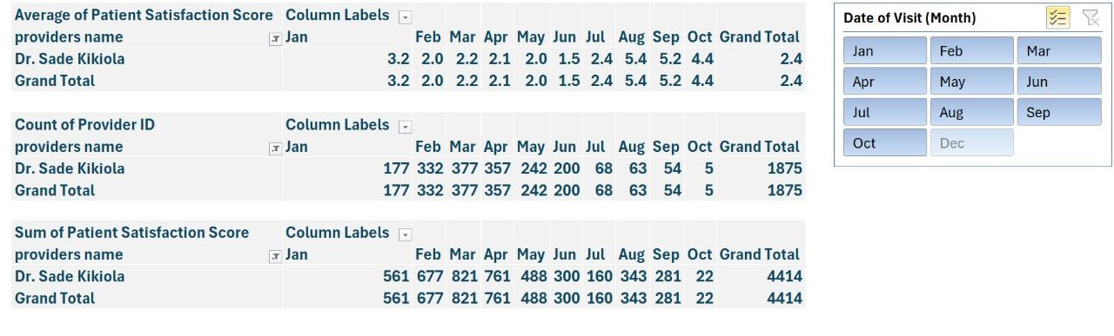
Relation Between rating for doctors and Their patients number
Although the (Dr.sade) has the lowest rating,
he has the largest number of patients.
Months with a high number of patients had a negative impact on evaluations, as the increased workload put pressure on staff and affected service quality.
Data Business Analyst

Slide 6
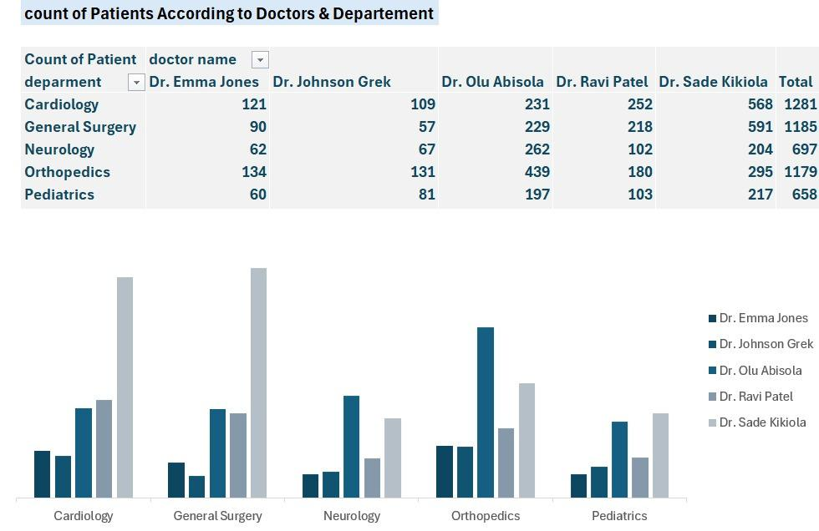
Distribution of patients according to departments and doctors
(Dr.sade KaKiola) the best doctor in Cardinology & General Surgery
pediatrics department need to doctor
we need to employ a manager for every department
we need reduce workload on
(Dr.sade KaKiola) in the other
departments
Data Business Analyst

Slide 7

>
Go to Excel For more information

Slide 8
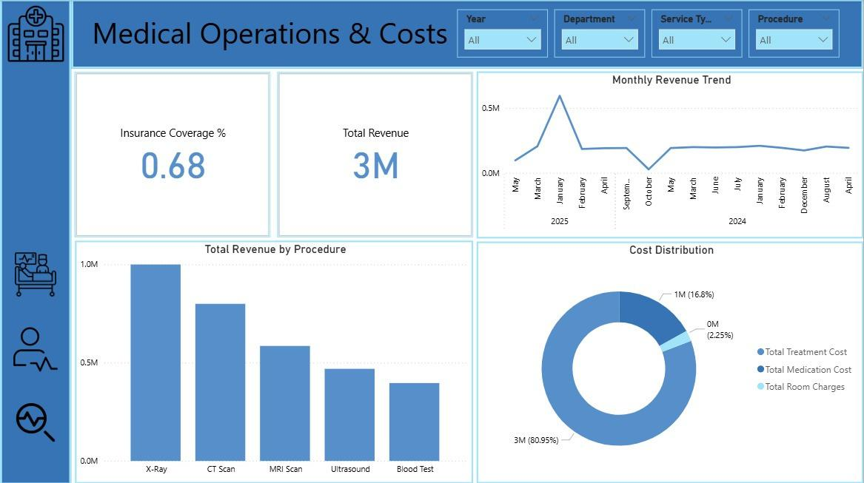

Slide 9
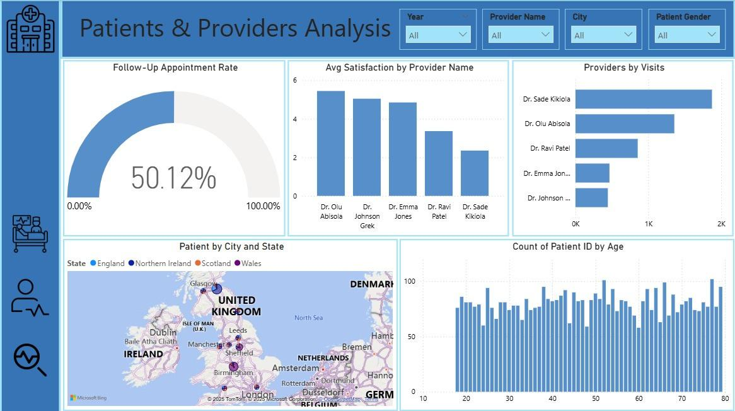

Slide 10
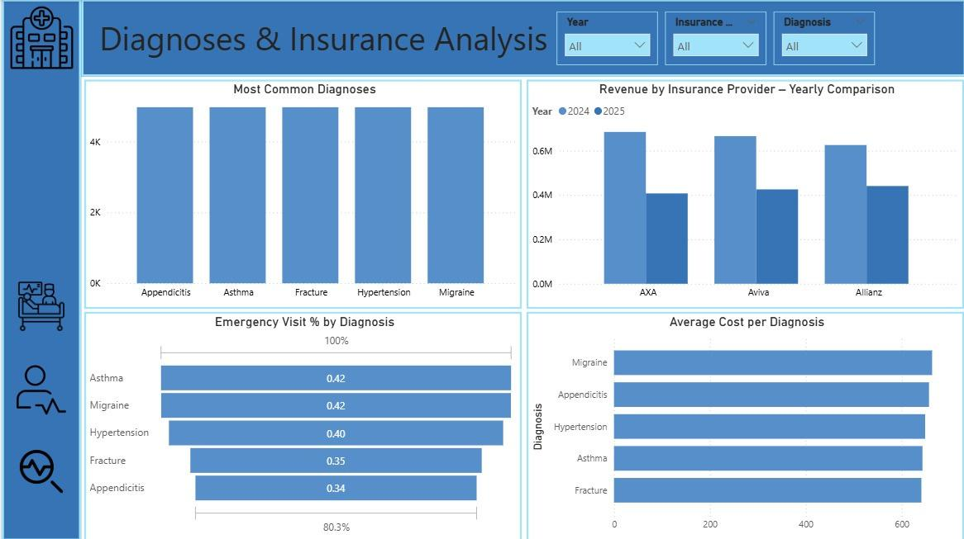

Slide 11
>
Go to power BI For more information

Slide 12
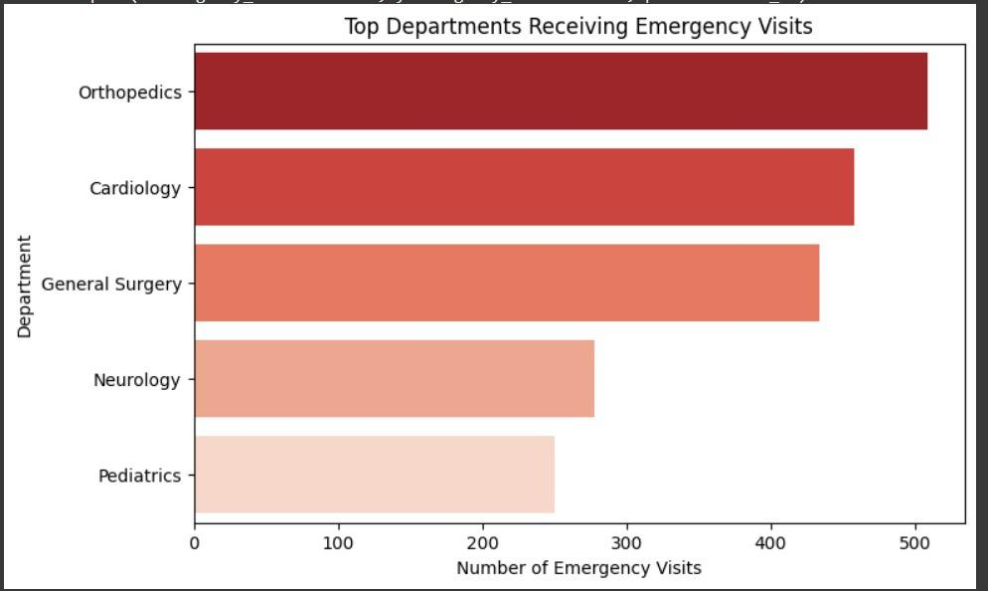
Arrangement of departments in terms of receiving emergency cases
This section is the section that receives the most emergency cases. We need to provide it with doctors and sufficient services to receive emergency cases at any time.
Data Business Analyst

Slide 13
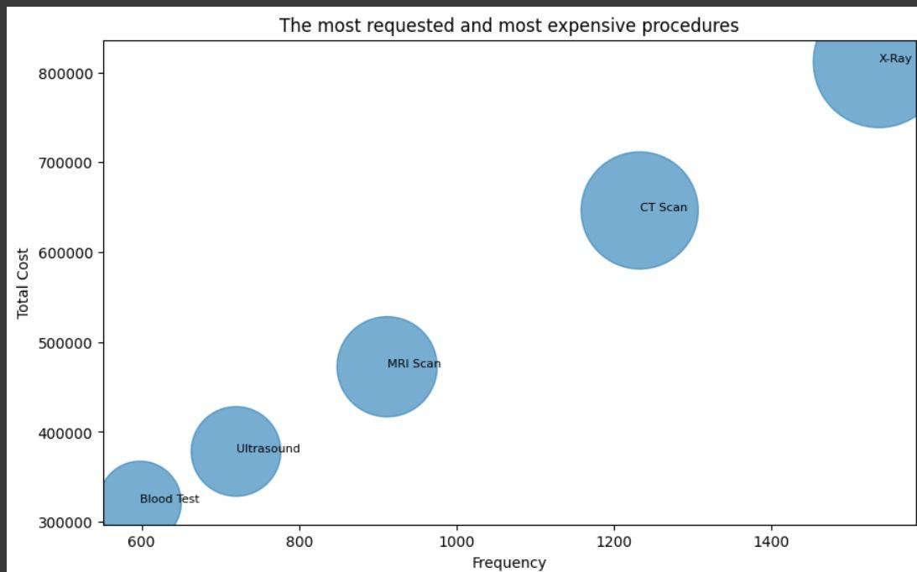
Procedures according to cost and frequency
The procedure X-Ray is the most frequently requested and most expensive procedure.
Data Business Analyst
Insurance should cover X-rays to a greater extent.
>

Slide 14
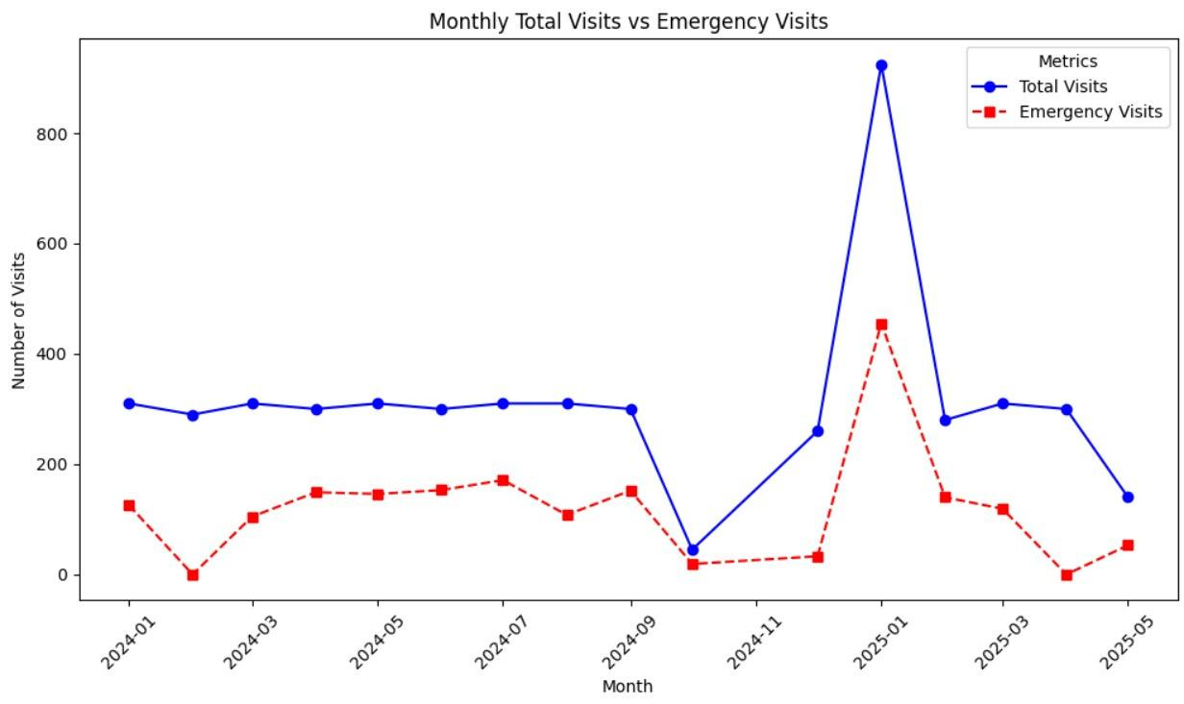
Track the percentage of emergency visits to total visits over the months.
Data Business Analyst
Emergency cases often represent half of all visits.
Therefore, the emergency department must have sufficient doctors and services dedicated to emergency care.

Slide 15
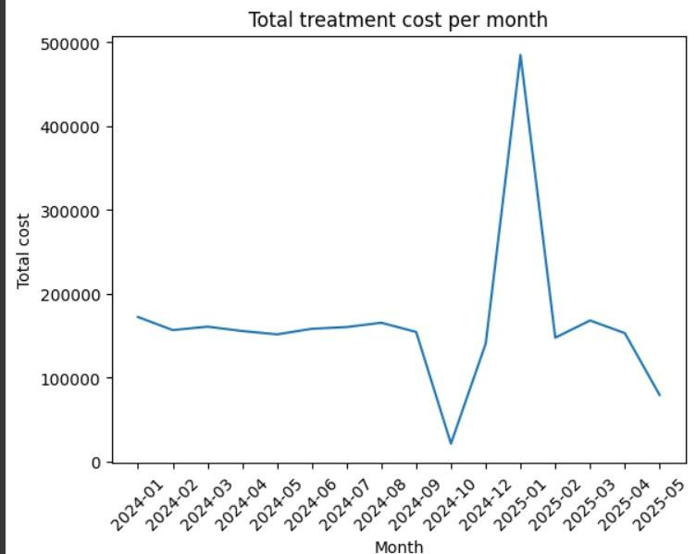
Cost over the months
Costs were stable in 2024
except in October, when a significant decline began to occur.
This was because visits in that month decreased significantly
in January, the largest increase in visits occurred, which led to the largest increase in costs.
May showed a decline in both costs and visits.
Data Business Analyst

Slide 16
>
Go to Notebook For more informations

Slide 17
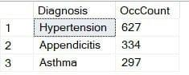
The three most common diseases among patients over 60 years old.
hypertension is the most frequently diagnose in age segment more than 60 years old
Data Business Analyst

Slide 18
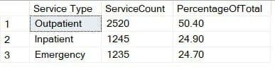
The percentage of each service type from the total visits.
Data Business Analyst
hypertension is the most frequently diagnose in age segment more than 60 years old

Slide 19
The percentage of each service type from the total visits.
Data Business Analyst
outpatient sevice is most frequently type

Slide 20
the most important KPIs :
>
Data Business Analyst
Go to sql queries For more informations

Slide 21
Machine Learning
Although the relationships in this data are very, very weak and there were many failed attempts, we tried to reach the best models to rely on without
DATA LEKAGE
>
Features Enginering
previse Visits
>
previse Emergencies
Encoding
last diagnose
Date of Visit
Service Type
Follow-Up Scheduled
Provider Name
etc....
days since last visit
>
mean score history
create two ML models
predict Emergency visits
mean score history
Satisfaction Category
predict Stasification

Slide 22
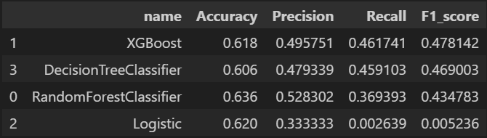
model for predict Emergency visits
Delete columns that cause Data Leakage and not exist before prediction
Emergency Visit - Medication Cost - Treatment Cost - total cost - Patient Satisfaction Score - Insurance Coverage
I started looking at the importance and choosing the ten most influential characteristics on the target.
I trained more than one model, compared the results, and chose the best one.
Data Business Analyst

Slide 23
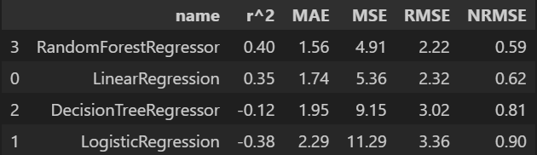
model for predict Stasification
Delete columns that cause Data Leakage and not exist before prediction
I started looking at the correlations and choosing the most influential characteristics on the target.
I trained more than one model, compared the results, and chose the best one.
>
When I got these bad results, I started thinking about making it a category and working on classification models → .
Data Business Analyst

Slide 24
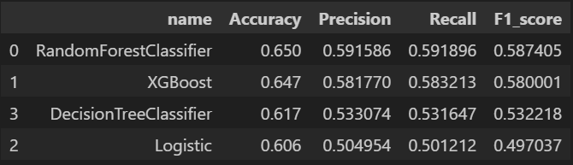
model for predict Stasification (Second attempt)
Delete columns that cause Data Leakage and not exist before prediction
I started looking at the importances and choosing the most influential characteristics on the target.
I trained more than one classification models, compared the results, and chose the best one.
Data Business Analyst

Slide 25
>
Go to Notebook For more informations

Slide 26
Thank You.
Data Business Analyst
2025

